Slide 1
The Committee on Eastern European Economic Relations
Economy connects

Slide 2
Internship Program of German Business for Ukraine 2017
a joint initiative of
Federal Ministry for Economic Cooperation and Development (BMZ)
Committee on Eastern European Economic Relations
Ukrainian Chamber of Commerce and Industry
Deutsche Gesellschaft für Internationale Zusammenarbeit (GIZ)

Slide 3
Internship Program of German Business 2016
The internship program provides
internships for highly qualified students / young graduates
in German companies in Germany
25 - 30 interns
3 - 5 months
Start: 1 February 2017
Support from the program
Monthly scholarship
Companies are taking care of rent and insurance
Travel costs to Germany and back home

Slide 4
Internship Program of German Business 2016
Application process
+++Before applying: please read
our homepage thoroughly+++
studies: economics/finance, engineering/ technics, informatics, agriculture, journalism/ media
students from 3rd year in their BA studies
students enrolled in MA / Phd studies
Young graduates (date of graduation 1 Aug 2015 or later)
Up to 30 years
Knowledge of very good English and/orGerman

Slide 5
Internship Program of German Business 2016
Online application period: 11 April – 3 June 2016 only via www.ost-ausschuss.de/ua
Please upload
1) CV & Letter of motivation (first pdf file)
2) Transcript of records & translation of transcript, letter(s) of recommendation (second pdf file)
Further steps after online application
June / July 2016 Interviews in Kiev, Kharkiv, Lviv, Odessa
July / August 2016 Final Shortlist
Sept – Nov 2016 Matchmaking & answers from companies
Nov / Dec 2016 Preparation (Visa, accomodation etc.)
February – June 2017 Internships

Slide 6
Internship Program of German Business 2016
www.ost-ausschuss.de/ua
www.european-office.org.ua
Further information available on
facebook.com/uainternship https://vk.com/UAinternship
Find us on facebook / vkontakte
Contacts
Stefan Kaegebein (Berlin, Committee on Eastern European Economic Relations)
s.kaegebein@bdi.eu; telephone: +49 30 2067 61 113
Martin Reuther (Kiev, Ukrainian Chamber of Commerce and Industry)
mreu.ucci@gmail.com; telephone: +380 63 589 74 94

Slide 7
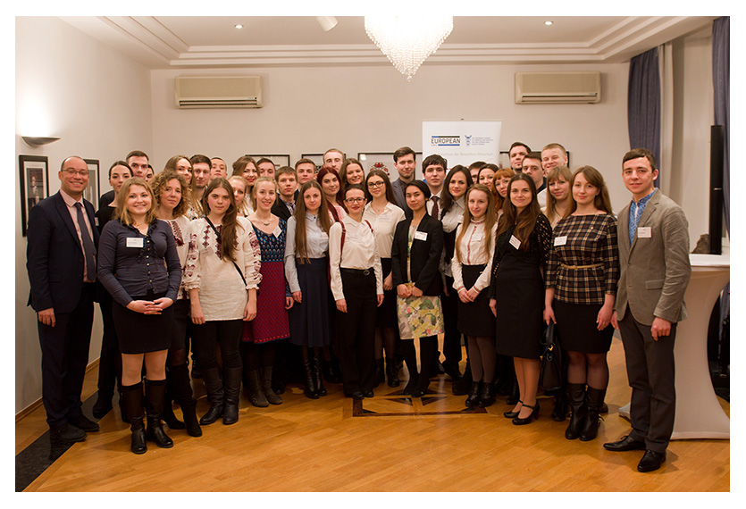
Internship Program of German Business 2016
Thank you for your attention !

